Slide 1
Class 12: Class Imbalance, Ridge Regularization
MGSC 310
Ben Labaschin

Slide 2
Class 12: Outline
Class Imbalance
Upsampling
Downsampling
Class Imbalance in Python
Ridge Regression
Cross-Validation
Ridge Regression in Python
Ridge Lab

Slide 3
Class Imbalance
As mentioned in the past, sometimes our data will be highly imbalanced
This can become an issue if there are too few observations for the model to pick up a “signal” or pattern in the data.
If we find ourselves with too few occurrences in our data, what do we do?

Slide 4
Upsampling
Definition: Increasing the number of samples in the minority class by replicating them.
Goal: Achieve a balanced dataset by making the minority class equal to the majority.
Method: Randomly duplicate samples or synthesize new ones.
Random Over-sampling: Directly duplicate samples from the minority class.
SMOTE (Synthetic Minority Over-sampling Technique): Generate synthetic samples by interpolating between existing minority samples.
Pros: Improves model sensitivity towards minority class.
Cons: Can lead to overfitting due to repeated samples.

Slide 5
Downsampling
Definition: Reducing the number of samples in the majority class by randomly selecting a subset.
Goal: Achieve a balanced dataset by reducing the majority class to the size of the minority class.
Method: Randomly eliminate samples or use structured techniques.
Random Under-sampling: Directly remove random samples from the majority class.
NearMiss: A collection of under-sampling methods that select samples based on the distance of majority class samples to minority class samples.
Pros: Reduces the risk of overfitting on the majority class.
Cons: Information loss as potentially useful samples from the majority class are discarded.

Slide 6
Class Imbalance: Upsampling and Downsampling
To the code!

Slide 7
Class 12: Outline
Class Imbalance
Upsampling
Downsampling
Class Imbalance in Python
Ridge Regression
Cross-Validation
Ridge Regression in Python

Slide 8
Recall: If Model is overfit, we want to reduce complexity
As we increase model complexity (number of variables, etc) we can see reductions in training error that don’t decrease test error
If we find we are overfit, what can we do?
Which variables should we reduce/remove?
Minimum of validation/ test error = optimal model complexity
Test error
Model
Error
Training error
Model complexity
(number of variables, degrees of freedom of model)

Slide 9
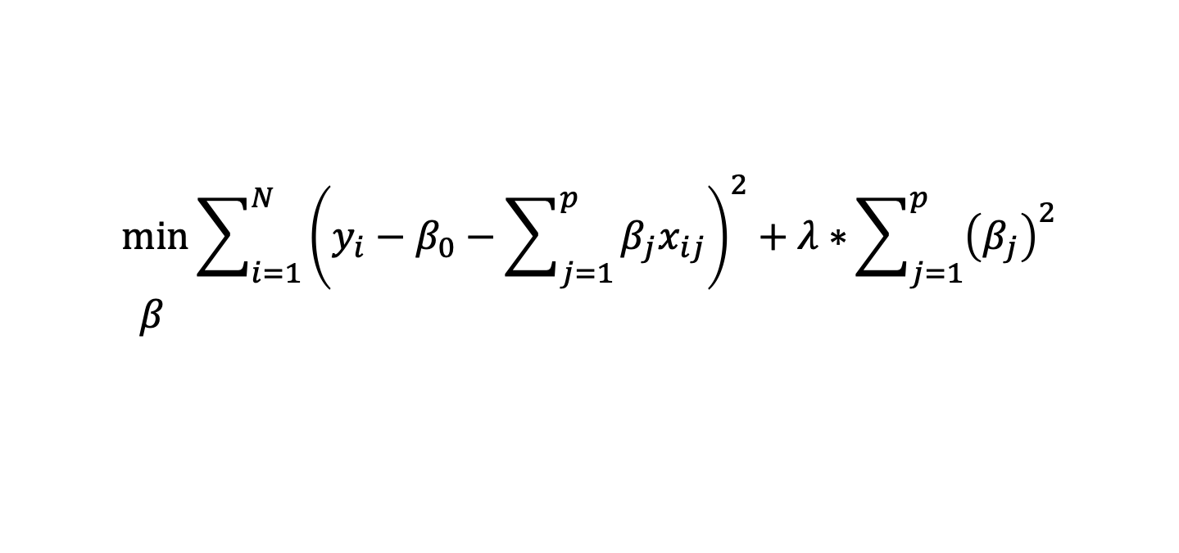

What is Ridge Regression?
Squared coefficients
Lambda “tuning” parameter
Ridge regression:
A type of linear regression that introduces a penalty on the magnitude of coefficients in the linear model.
Penalty helps control the complexity of the model,
Useful when:
multicollinearity is present
when the number of features exceeds the number of observations

Slide 10
Ridge Lambda Estimator
Squared coefficients
Lambda “tuning” parameter
𝝀 is critical to the equation! It controls the amount of “shrinkage” or penalization in the mode, reducing model complexity
If 𝝀 = 0, we get linear regression!
As 𝝀 increases, we reduce model complexity

Slide 11
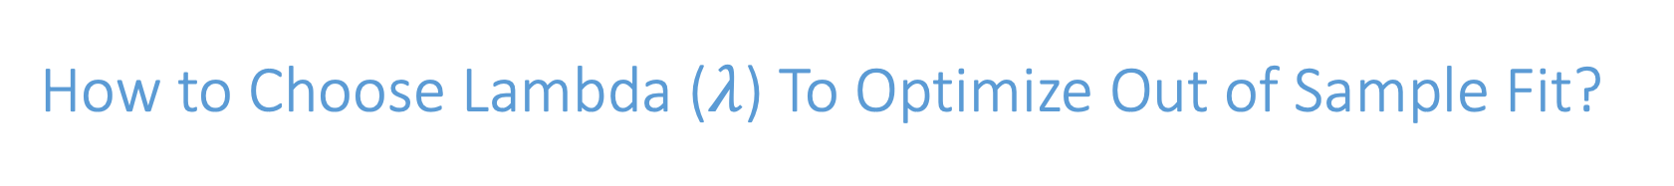
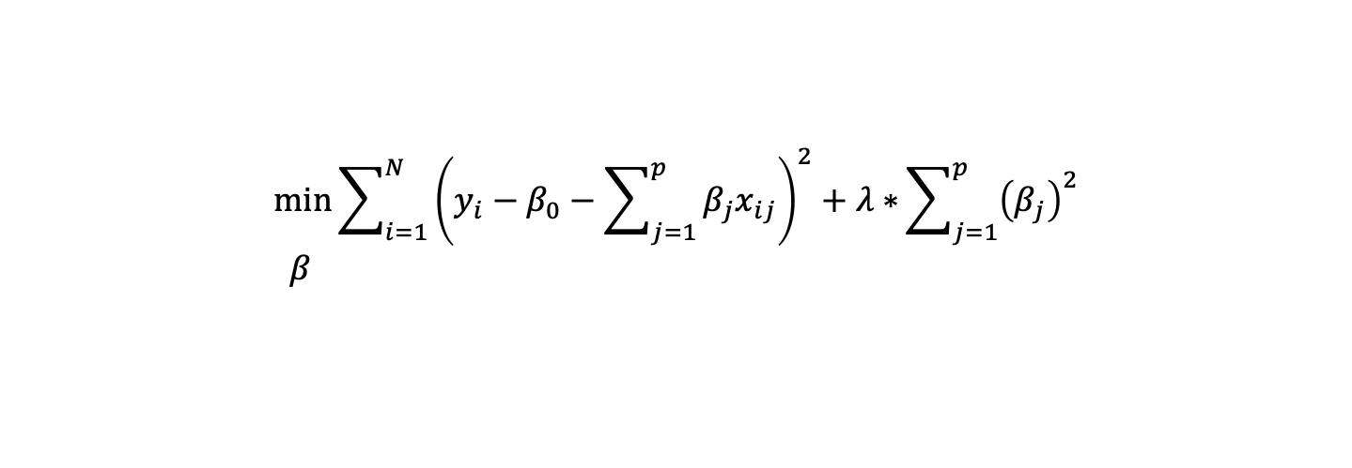



If 𝝀 is too low, our model will be overfit
If 𝝀 is too high, our model will be underfit
We need to find an optimal 𝝀* to reduce our out-of-sample error… How? We will use a technique called
cross-validation that approximates the error
of our model in the test set
Test error
Model
Error
Training error
Model complexity
(number of variables, degrees of freedom of model)

Slide 12
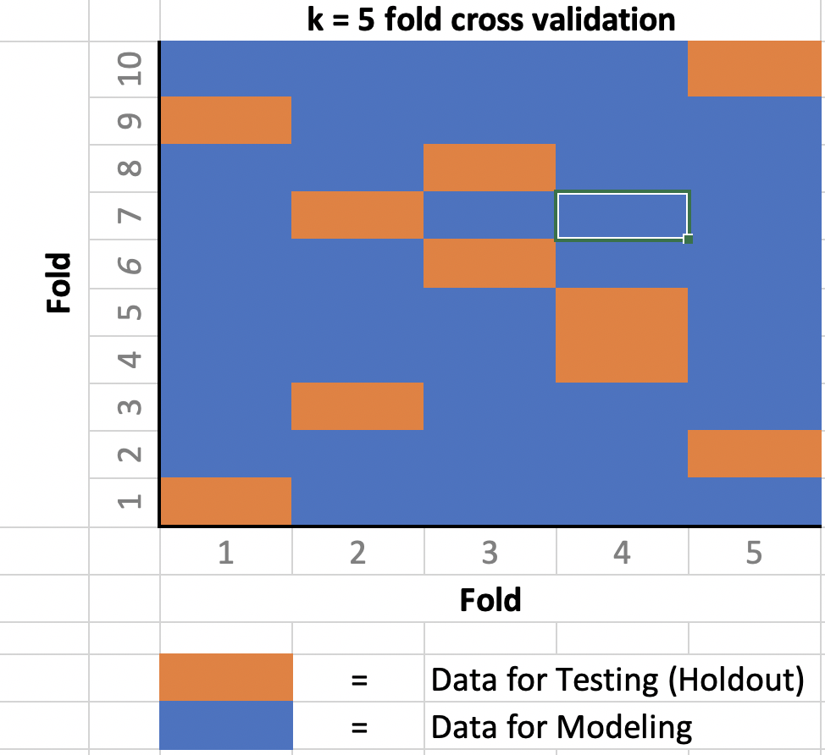
K-Fold Cross-Validation
In K-Fold Cross Validation we partition (divide) data into K distinct groups
Fit a model using data excluding group 1, use that model to predict into group 1.
Fit a model using data excluding group 2, etc
Proceed until we have yhats for every group
Observation

Slide 13



Resampling: K-Fold Cross-Validation
We start by randomly assigning each data point to one of k folds
Here we are setting k = 3
We fit a model excluding data from fold 1
That model is used to predict into fold 1
 | Fold | mpg | cyl | Displ
 | 3 | 20 | 4 | 3
 | 2 | 15 | 6 | 5
 | 3 | 12 | 4 | 2.4
 | 1 | 10 | 8 | 4.6
 | 2 | 14 | 6 | 3
 | 1 | 25 | 4 | 2
11
22

Slide 14



Resampling: K-Fold Cross-Validation
Here we are setting k = 3
Next we fit a model excluding observations in fold 2
That model is used to predict into fold 2
 | Fold | mpg | cyl | Displ
 | 3 | 20 | 4 | 3
 | 2 | 15 | 6 | 5
 | 3 | 12 | 4 | 2.4
 | 1 | 10 | 8 | 4.6
 | 2 | 14 | 6 | 3
 | 1 | 25 | 4 | 2
18
11
15
22

Slide 15



Resampling: K-Fold Cross-Validation
Here we are setting k = 3
Next we fit a model excluding observations in fold 3
That model is used to predict into fold 3
 | Fold | mpg | cyl | Displ
 | 3 | 20 | 4 | 3
 | 2 | 15 | 6 | 5
 | 3 | 12 | 4 | 2.4
 | 1 | 10 | 8 | 4.6
 | 2 | 14 | 6 | 3
 | 1 | 25 | 4 | 2
22
18
12
11
15
22

Slide 16
Ridge Regression and Cross Validation in Python
To the code!

